Slide 1
Enhancing a Basic Paper Report
Notes:
Schedule: Timing Topic
<xx> minutes Lecture
<xx> minutes Practice
<xx> minutes Total

Slide 2
Objectives
After completing this lesson, you should be able to do the following:
  Describe the Paper Design view
  Modify the display of report data in the Paper Design view
  Modify the positioning of report data
  Highlight data using conditional formatting
  Add page numbering and the current date

Slide 3
What Is the Paper Design?
  The Paper Design is a view of report output that
  allows live editing of text and paper layout attributes:
  True WYSIWYG report editing
  Easy editing: See it. Click it. Change it.
  Cached report data

Slide 4
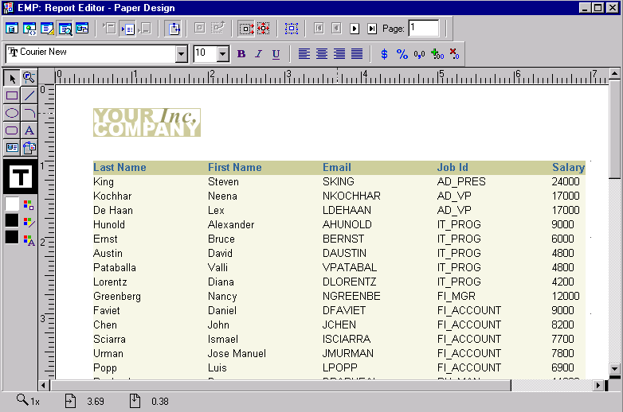
The Paper Design Window
1
2
3
4

Slide 5
Modifying a Report
Common modifications:
  Align columns
  Set format masks
  Manipulate objects
  Edit text
  Modify visual attributes
  Highlight data using conditional formats
  Insert page numbers and current date

Slide 6
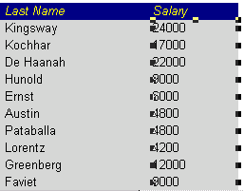
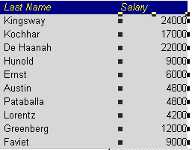
Aligning Columns
Point and
select
Select
“Align Right”

Slide 7
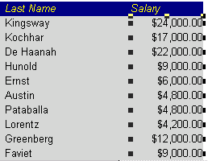

Setting a Format Mask
Change format masks from the stylebar
1
2
3
4
5

Slide 8

Manipulating Objects
  Clear fields
  Move fields
  Resize fields
Flex Mode adjusts layout during changes.

Slide 9
Modifying Visual Attributes
  Modify text colors and fonts
  Edit text
  Set fill, patterns, and colors
  Use the Parent Frame tool
  to select an enclosing object
-Sales Report -
Year Region Sales
1993 Americas 200
1993 Europe 400
1993 Asia Pacific 770
Year Region Sales
1994 Americas 210
1994 Europe 390
Sales Report by Area
Year Region Sales
1993 Americas 200
1993 Europe 400
1993 Asia Pacific 770
Year Region Sales
1994 Americas 210
1994 Europe 390
Sales Report by Area
1993 Americas 200
1993 Europe 400
1993 Asia Pacific 770
1994 Americas 210
1994 Europe 390
Year Region Sales
Year Region Sales

Slide 10
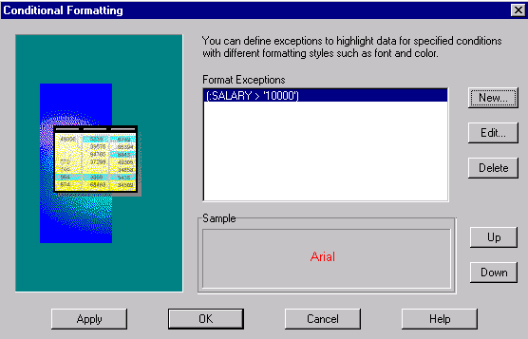
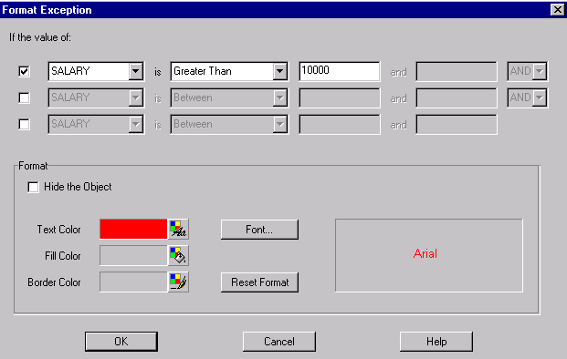
Applying Conditional Formatting

Slide 11
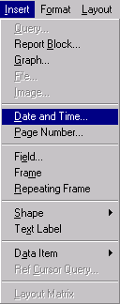
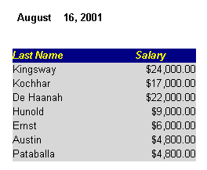
Inserting Page Numbers, Dates, and Times
  Inserted easily
  Customizable extensions

Slide 12
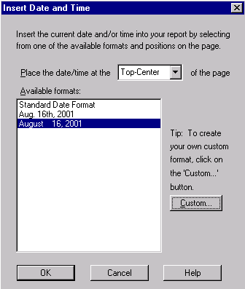
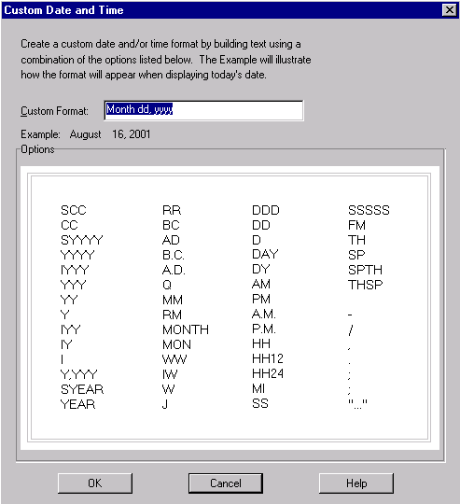
Customizing Dates

Slide 13
Summary
  In this lesson, you should have learned how to:
  Enhance report output using live data:
    Move, resize, delete objects
    Edit text
    Alter fonts, colors, and patterns
    Apply format masks
    Add page numbering and current date
  Save report to preserve changes

Slide 14
Practice 5 Overview
  Modifying reports by applying changes in the Paper
  Design view

